Slide 1
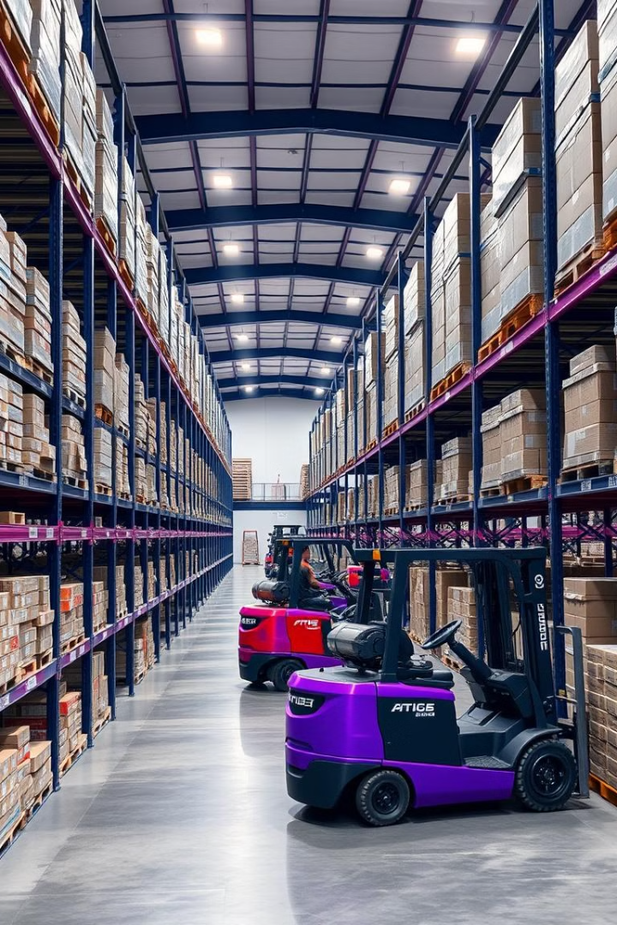

Inventory Management System with Rails and PostgreSQL
In this presentation, we'll explore how to build a powerful inventory management system using the Ruby on Rails framework and the PostgreSQL database. We'll dive into the benefits of centralized inventory, the system architecture, database design, and key features to streamline your operations.
by Robert Alabi

Slide 2

Introduction to Inventory Management
1
Gain Visibility
2
Reduce Costs
Track stock levels, item details, and movement to make informed decisions.
Minimize over-stocking, waste, and unnecessary expenses.
3
Improve Efficiency
Automate processes and streamline workflows for your business.

Slide 3

Benefits of a Centralized Inventory System
Single Source of Truth
Real-Time Updates
Maintain a unified view of inventory across all locations and channels.
Immediately reflect changes in stock levels, orders, and adjustments.
Improved Forecasting
Use historical data to predict demand and optimize inventory levels.

Slide 4
Architecture Overview: Rails and PostgreSQL
Ruby on Rails
PostgreSQL
A powerful web application framework that simplifies development and provides robust features for inventory management.
A reliable, scalable, and feature-rich open-source database system, ideal for storing and managing inventory data.

Slide 5
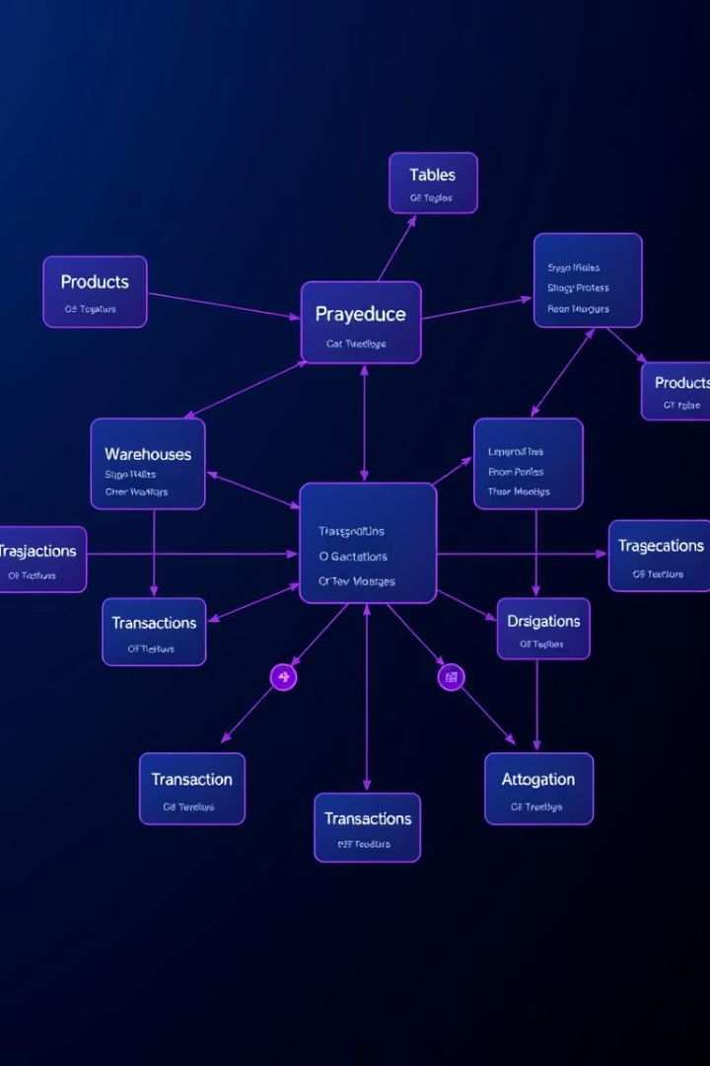
Database Design and Entity Relationships
Products
Warehouses
Catalog of all items, including details like SKU, description, pricing, and categories.
Multiple locations for storing inventory, with attributes like address, manager, and capacity.
Transactions
Historical record of all stock movements, including purchases, sales, and adjustments.

Slide 6
Implementing CRUD Operations
Create
Read
Update
Delete
Add new products, warehouses, and transactions through intuitive user interfaces.
View real-time inventory levels, transaction history, and other reporting data.
Modify product details, warehouse information, and adjust inventory quantities as needed.
Remove obsolete or discontinued items from the system in a controlled manner.

Slide 7

Integrating with Ecommerce Platform
1
Sync Inventory
Automatically update online product listings with real-time stock levels.
2
Order Processing
Seamlessly fulfill customer orders by reserving and dispatching inventory.
3
Analytics
Leverage sales data to optimize inventory levels and make informed business decisions.

Slide 8
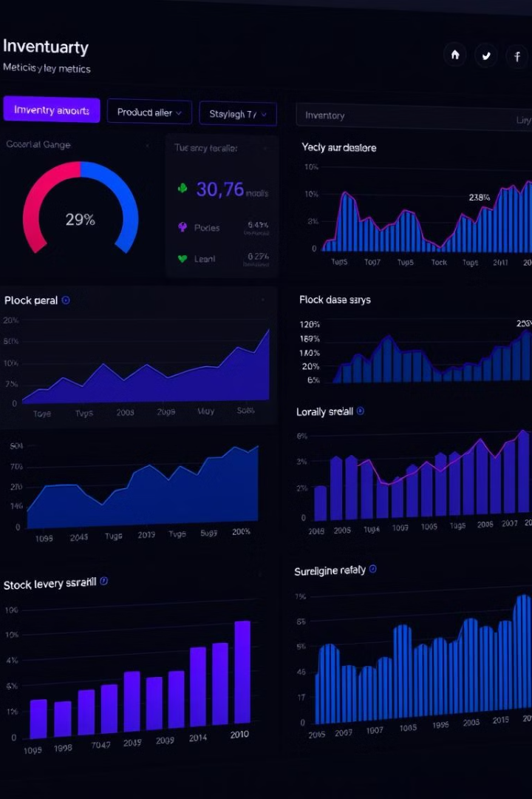



Reporting and Analytics
Sales Reports
Track product performance, revenue, and customer trends.
Inventory Reports
Monitor stock levels, aging, and turnover by location and category.
Forecast Reports
Predict future demand and optimize inventory investment.

Slide 9

Handling Inventory Adjustments
1
Physical Counts
Regularly audit inventory levels to identify and correct discrepancies.
2
Adjustments
Easily log gains, losses, and transfers to maintain accurate inventory records.
3
Auditing
Review adjustment history and investigate trends to improve inventory management processes.

Slide 10

Conclusion and Next Steps
Key Takeaways
Next Steps
Contact Us
Centralized inventory management, real-time visibility, and seamless ecommerce integration.
Implement the Rails-based inventory system, integrate with your business, and continuously optimize operations.
Reach out to our team to discuss your inventory management needs and how we can help.

